Slide 1



Data Science and Machine Learning
CONFIDENCE INTERVALS

Slide 2
INFERENCE - SEARCHING THE POPULATION MEAN
Let’s suppose we want to infer the population mean (𝜇) from a sample.
Whenever we present an estimate of a population parameter, it is good practice to give it as a confidence interval.
Rather than
The mean for the population is...
Go for
The mean for the population is between … and ...
What would affect the width of a confidence interval?

Slide 3
WHAT AFFECTS THE WIDTH OF A CONFIDENCE INTERVAL?
True variation
Sample variation
Confidence
The more real variance our dataset has, the more leeway we have to give to our interval. Any sample is going to be “all over the place”
Small samples will vary more from each other and large samples will be more similar to each other.
The more confident we want to be about the true value of the parameter being in our interval, the more lenient we have to be on the boundaries of the interval
“I am very sure the average height of people in Lisbon is somewhere between 50cm and 3m” vs “I think the value is 1.7933m, but this is purely a guess”

Slide 4
WHAT AFFECTS THE WIDTH OF A CONFIDENCE INTERVAL?
True variation
Sample variation
Confidence
Let’s assume for now we know the standard deviation (𝝈) of our distribution*.
The standard deviation of the sampling distribution is higher with 𝝈, but can be controlled with a higher n
We choose a “confidence level” (c). Typical values for c are 95% or 99% or even greater.
*We will later see that we can use the sample standard deviation (s) without adverse effects, but for now let’s assume we know 𝝈

Slide 5
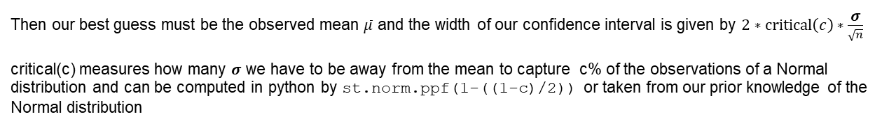
WHAT AFFECTS THE WIDTH OF A CONFIDENCE INTERVAL?
True variation
Sample variation
Confidence
Let’s assume for now we know the standard deviation (𝝈) of our distribution*.
The standard deviation of the sampling distribution is higher with 𝝈, but can be controlled with a higher n
We choose a “confidence level” (c). Typical values for c are 95% or 99% or even greater.
*We will later see that we can use the sample standard deviation (s) without adverse effects, but for now let’s assume we know 𝝈

Slide 6

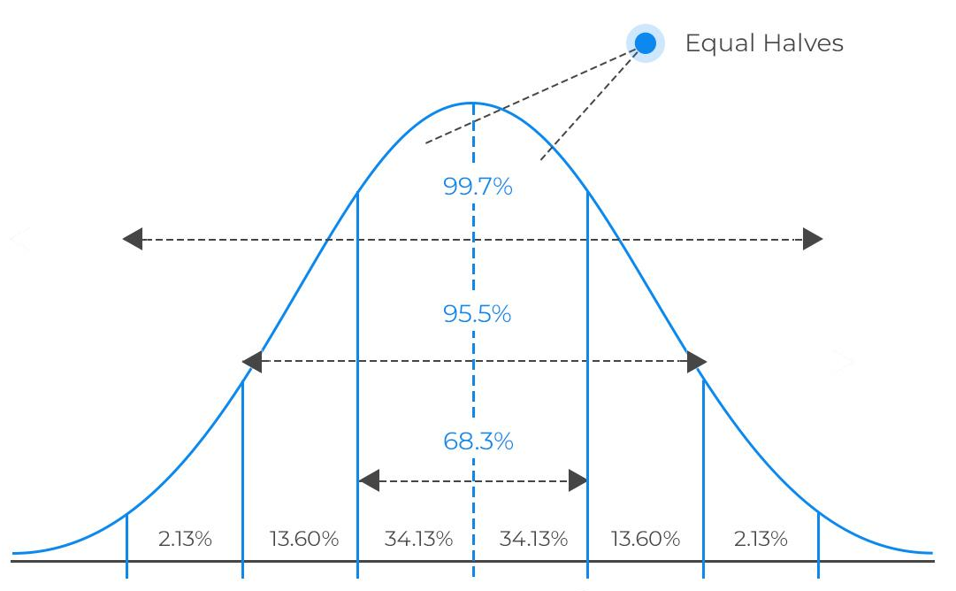
CONFIDENCE INTERVAL FOR THE MEAN
Say 𝝈=2 and we sampled 𝒏=16 observations, with sample mean 𝒙=3.5
For 95.5% confidence, critical(0.955) = 2 (see chart)
Therefore 𝜇 is between 2.5 = 3.5 - 2*(2/sqrt(16)) and 4.5 = 3.5 + 2*(2/sqrt(16)) with confidence 95%
2.5
𝒙=3.5
4.5
With 99.7% confidence, critical(0.997) = 3 (see chart)
Therefore 𝜇 is between 2 = 3.5 - 3*(2/sqrt(16)) and 5= 3.5 + 3*(2/sqrt(16)) with confidence 99.7%
2.0
𝒙=3.5
5.0

Slide 7

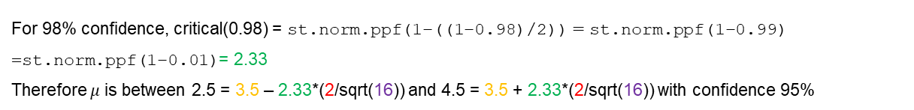
Critical Values
What if we don’t want 95.5% or 99.7% confidence?
You can have any confidence value that you want. Notice that the 95.5% (resp. The 99.7%) came from knowing that this much probability was captured up to 2 (resp 3) standard deviations away from the mean.

Slide 8
𝛔 UNKNOWN
In most real life scenarios, we won’t know the population standard deviation 𝝈. Turns out that the sample standard deviation (𝒔) is an unbiased estimator to 𝝈, which means that for “large” values of 𝒏 we can use 𝒔 in the place of 𝝈.
What is “large”?
What if we don’t have “large” 𝒏?
Fear not, we have the T-distribution for these cases!

Slide 9
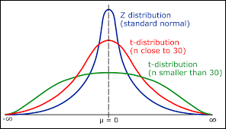
THE T-DISTRIBUTION(S)
There is one T-distribution for each value of 𝒏 (annoyingly, the 𝒏-1 T-distribution is associated with sample size 𝒏. It is said that the distribution has 𝒏-1 degrees of freedom). The T-distribution approximates the sampling distribution, accounting for the error of using sample std 𝒔 instead of 𝝈 .
T_n is “fatter” than Gaussian
Lower kurtosis
More extreme values
The higher the n, the closer to Gaussian
Take-away:
When we don’t know the population std 𝝈 or when 𝒏<30, we use instead the sample std 𝒔 and query the T-distribution 𝒏-1

Slide 10
T-VALUES
Like before, we get a t-value associated with each confidence level c.
But now we also have to take into consideration degrees of freedom.
import scipy.stats as st
t = st.t.ppf(1-((1-c)/2),n-1)
We then compute our interval as
𝒙 ± t * 𝛔/sqrt(𝒏)

